Slide 1
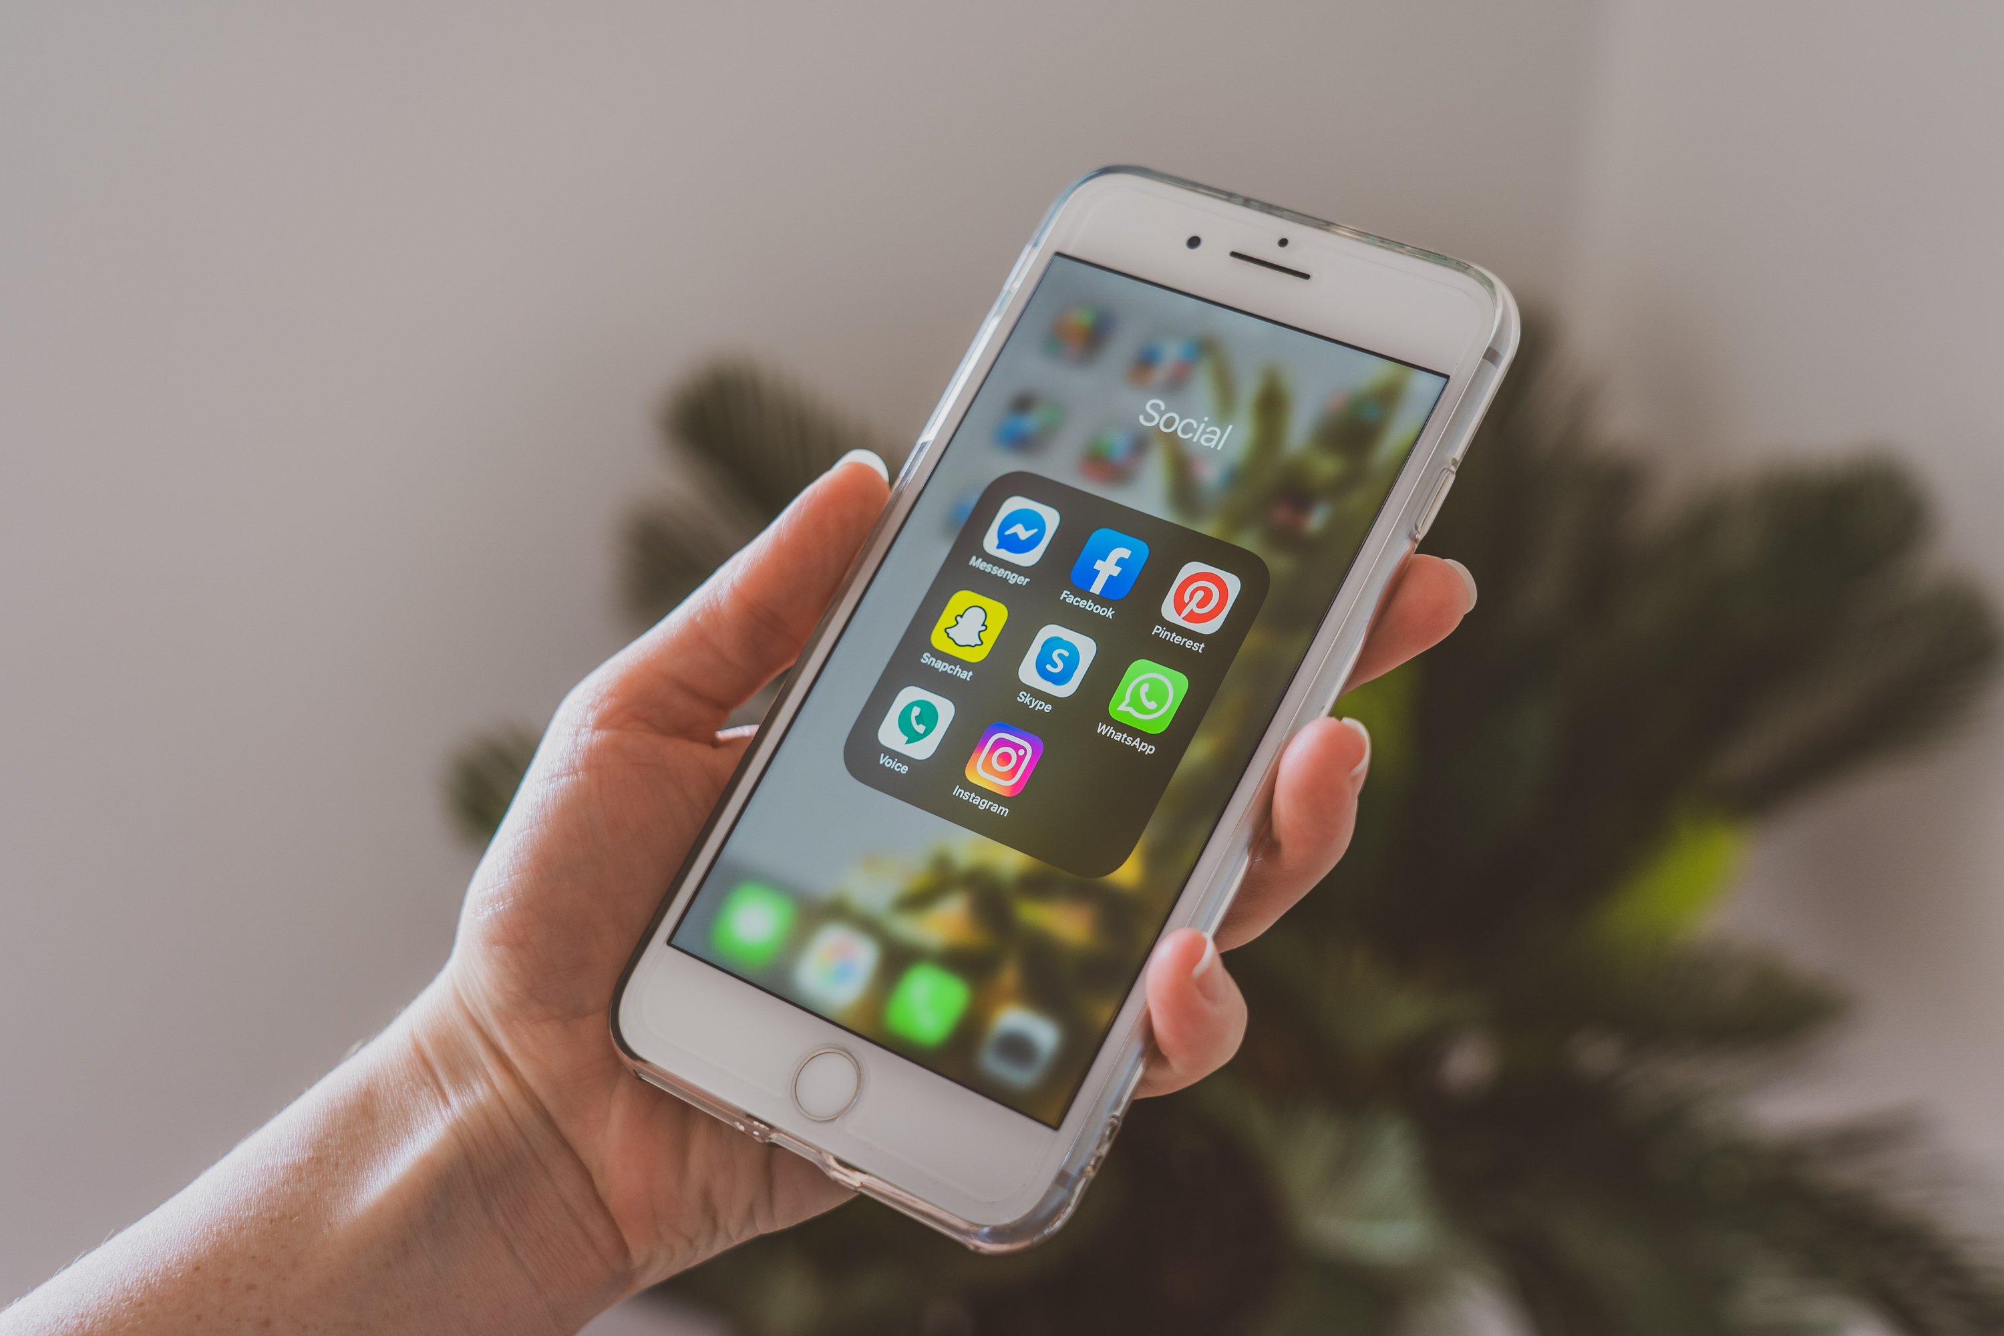
Physical Smart Box
Pitch Deck
Envisage 2.0

Slide 2

Physical Smart Box
The Problem statement
Enhancing focus and minimizing distractions from mobile devices to empower individuals to complete tasks efficiently, stay on track, and boost productivity, ensuring optimal performance in their studies, work, or professional responsibilities without procrastination.
Claim Used

Slide 3

Problem Understanding
Physical Smart Box
Before Smartphones:
Early
2000s
Screen time was primarily limited to TV and computers.
After Smartphones:
2010s
With the rise of smartphones, screen time increased dramatically. By 2023, the average global screen time reached about 6 hours and 40 minutes per day.
Children and Teens: Screen time among children (8-12 years) in the US increased from 4 hours 36 minutes in 2015 to 5 hours 33 minutes in 2021. For teens (13-18 years), it rose from 6 hours 40 minutes in 2015 to 8 hours 39 minutes in 2021.
Onwards:

Slide 4
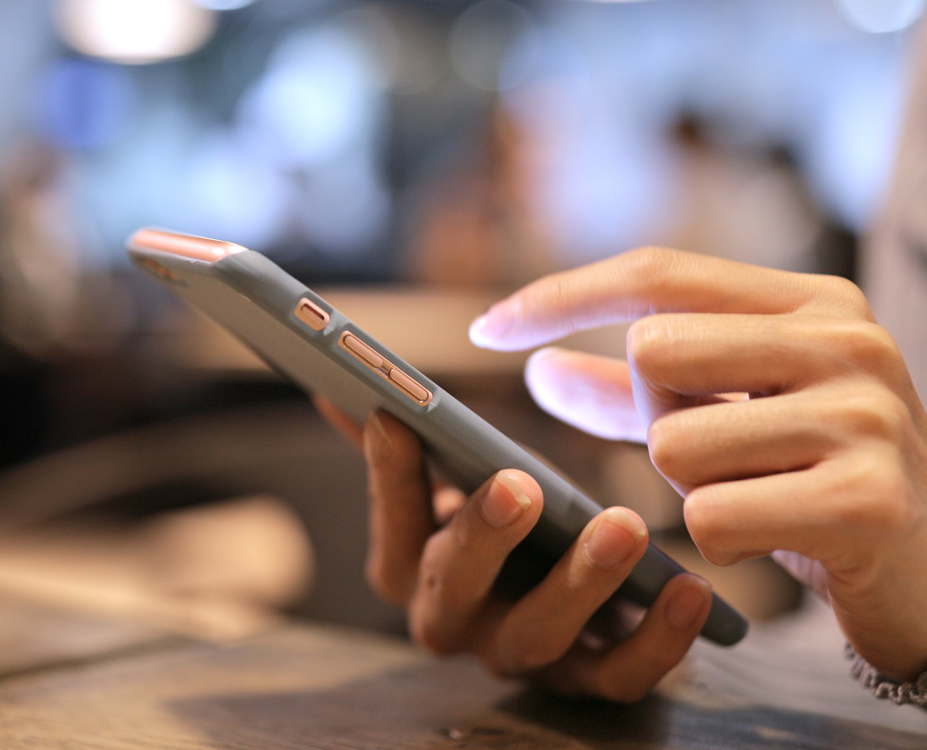
Decrease in Productivity
Interruptions:
Frequent notifications and the urge to check phones disrupt the flow of work, making it harder to maintain concentration.
Multitasking:
The constant switching between tasks on smartphones can lead to reduced efficiency and increased errors.
Physical Smart Box
Increase in Procrastination
Instant Gratification:
Social media, games, and other apps provide immediate rewards, making it easy to delay important tasks.
Emotional Regulation:
People often use their phones to cope with negative emotions, which can lead to procrastination.
Conclusion
The rise of smartphones has led to a significant increase in screen time, which has been linked to decreased productivity and increased procrastination. Balancing smartphone use with productive activities is crucial to mitigate these effects.

Slide 5




Vision and Business Model
Physical Smart Box
Vision
To decrease mobile usage
To improve health of eye
Bettering mental wellbeing
To do tasks on time
Increasing focus time of people

Slide 6









KEY PARTNERS
KEY ACTIVITIES
VALUE PROPOSITIONS
CUSTOMER RELATIONSHIP
CUSTOMER
SEGMENTS
Manufacturers:
Reliable, low-cost hardware manufacturers for production.
App Developers:
Third-party developers for app features and integration.
Logistics Providers:
Shipping partners for smooth distribution.
Institutional Partnerships:
Collaborations with schools and workplaces to promote bulk sales.
Product Development:
Designing and refining the PSB.
App Maintenance:
Ensuring a smooth user interface and functionality of the companion app.
Marketing:
Building awareness through digital campaigns targeting students, professionals, and institutions.
Customer Support:
Troubleshooting and providing assistance via the app or website.
Device Locking System:
Ensures users stay focused by securely locking phones away.
Emergency Access:
Allows users to receive emergency calls via speaker and microphone on the PSB while the phone is locked.
App Integration:
Users can interface with the PSB through a dedicated app for convenient control and monitoring. This includes saving tasks to be done while the phone is in PSB, reminding the user about the task frequently, and keeping them on track.
Customizable Timer:
Manual adjustment of hours and minutes for a personalized locking experience.
Charging Inlet:
Keeps the phone charged while stored, removing the need to access the phone for charging.
Automated Support:
In-app customer service and troubleshooting.
Online Community:
Provide user forums for product tips and best practices.
Direct Feedback Loop:
Collect user insights through the app for continuous improvement.
Students:
Needing focus during study sessions.
Professionals:
Workers in productivity-oriented environments who want to avoid distractions.
Parents:
Seeking to manage screen time for children.
Institutions/Workplace:
Schools, universities, and offices that enforce device-free zones.
KEY
RESOURCES
CHANNELS
App Development:
A user-friendly mobile app to control the PSB.
Hardware Components:
Speaker, microphone, locking mechanism, touchscreen.
Manufacturing:
Low-cost, durable materials for mass production.
Logistics and Distribution:
Shipping and inventory management for retail and online sales.
Online Store:
Direct sales through your website or e-commerce platforms like Amazon, Flipkart...
Retail Partnerships:
Partner with electronics or office supply stores.
Educational and Workplace Institutions:
Bulk sales to institutions looking to enforce phone-free environments.
BUSINESS MODEL CANVAS
COST STRUCTURE
REVENUE STREAM
Manufacturing Costs:
Production of the smart box components (locking mechanism, electronics).
App Development Costs:
Initial and ongoing development, including bug fixes and updates.
Distribution Costs: Shipping and logistics for product delivery.
Marketing Expenses: Digital marketing and advertising.
Customer Support: Maintaining a support team for app and product-related issues.
Product Sales:
Direct purchase of the Physical Smart Box.
Subscription Model:
Monthly or annual subscription for enhanced app features (e.g., premium control options, Emergency unlocking passes etc.).
Institutional Contracts:
Bulk pricing for educational and workplace institutions including entrance coaching centers and tuition centers.

Slide 7

Innovativeness of the Solution
Physical Smart Box
01
Physical Locking Mechanism for Digital Focus
02
Parental control and a dedicated app to improve productivity of children
03
Adjustable Time Locking Feature
04
Emergency Override Option(Limited access)
05
Selective Access to Important Calls and Notifications

Slide 8
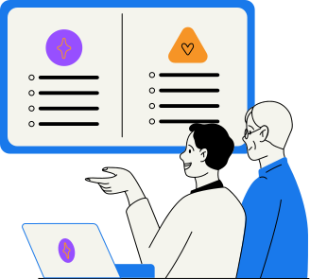
Physical Smart Box
Existing products that could challenge us
01
KSafe (Kitchen Safe)
02
Phone Lock Boxes (Generic)
03
DistractaGone

Slide 9

Our Innovation & Future Prospects
Physical Smart Box
01
Access to only Emergency calls (Smart Phone will be completely hidden for less temptation)
02
Integrating an AI driven productivity app
03
Focus Tracking with credits points for better performance
04
Multi-Function Display which only gives access to emergency call and To-do List
05
Built-In Charging Capability
06
Limited Emergency Unlocks(After which paid)
07
Portable and Tough Design

Slide 10













Physical Smart Box
01
Identify your target audience
03
Partner with Influencers
Students: People studying for exams or trying to focus.
Professionals: Workers who need to concentrate without distractions.
Parents: Families who want to limit their children’s phone use.
Productivity & Wellness Enthusiasts: People who care about mindfulness and reducing screen time.
Productivity and Wellness Influencers: Work with influencers who talk about focus, time management, and mental health to showcase your product.
Go To
Market Strategy
04
Sell Online
E-commerce: Start by selling on Amazon, our own website, or platforms like Etsy (Since it's a unique product).
Crowdfunding: Launch a Kickstarter or Indiegogo campaign to raise funds and get early buyers.
02
Highlight Your Unique Features:
Physical Lock + Smart Features: Emphasize that your device not only physically locks the phone but also filters important notifications (calls, texts) while blocking distractions.
Focus and Productivity: Show how it helps people focus better by removing temptation to check their phone.
05
Digital Marketing
Social Media Ads: Run ads on platforms like Instagram and Facebook targeting students, workers, and parents.
Google Ads: Use Google Ads to target people searching for focus and productivity tools.

Slide 11




Physical Smart Box
Technical Feasibility
Smartphone Connection: You can make the device smart by connecting it to your phone via Bluetooth or Wi-Fi. This way, it could block unimportant notifications but still allow important calls or messages.
Challenges: Making the device work with both Android and iPhones can be tricky. Android is more flexible, but iPhones have stricter rules, so you’ll need expert developers. Which can be addressed by initial use in Android for India then Expanding to iPhone Compatibility for US and other countries which have more iPhone users
Microcontroller: The core electronic system would need a microcontroller (such as Raspberry Pi Zero, ESP32, or similar) to manage operations like locking, timer control, and interfacing with the mobile phone app. These are affordable, power-efficient, and readily available.
Charging Inlet: USB or wireless charging components are well-established and can easily be integrated into the box.
App Development: Creating an app to interface with the PSB would involve standard mobile development (Android/iOS) using popular frameworks (Flutter or React Native) for cross-platform support. AI components such as productivity suggestions can be integrated using AI tools like OpenAI’s GPT models or similar cloud-based AI services. However, AI functionalities will require ongoing maintenance and improvements.
2. Market Feasibility
c Development Costs:
Hardware: Designing and manufacturing the physical lock could be relatively inexpensive if it’s a simple mechanical lock, but costs will go up if you add smart features.
Software: Developing an app to control the lock will cost money, especially if you need it to work on both Android and iPhones.
Funding: You could raise money through crowdfunding (e.g., Kickstarter) or investors if the idea looks scalable.
Feasibility
3. Financial Feasibility
Market Demand: People are increasingly trying to reduce distractions from their phones, so there is a demand for this kind of product. Your device can appeal to students, professionals, parents, and anyone trying to focus more.
Competitors: There are some physical lock devices and apps already out there, but your product is different because it offers both a physical lock and smart features like filtering important notifications.
Market Value: The market for productivity tools and apps is growing rapidly as more people struggle with managing screen time and distractions. In 2022, the global productivity management software market was valued at $47 billion and continues to grow.
4. Operational Feasibility
Manufacturing: There are plenty of companies that can help you build the device once you design it. You just need to make sure it’s durable and works reliably.
Distribution: You can sell it online through platforms like Amazon or through your own website. Partnering with productivity or wellness communities could help get more attention.

Slide 12
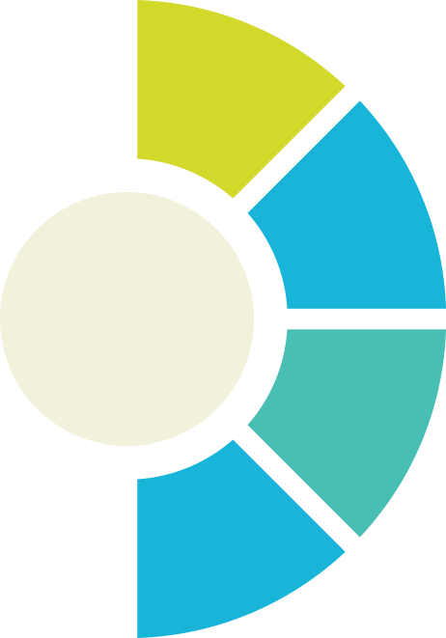
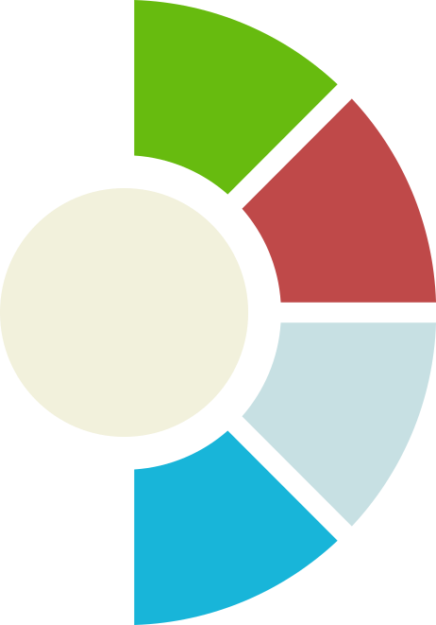

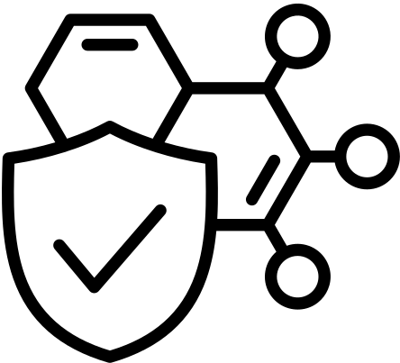


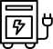

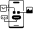
PRACTICALITY
Physical Smart Box
Dimensions and Design
Materials for Manufacturing
Dimensions (7.5*4.5*1.2 inches), Space for Components like the speaker, microphone, lock, and charging inlet. Careful planning is needed to ensure efficient use of this space.
Plastic/ABS Housing
Electronic Display system
Locking system
Battery housing
Components
Power Supply
Speaker and Microphone for Emergency Calls, Touchscreen and App Icons, Timer with Manual Adjustments, Mobile Charging Inlet
The PSB can be powered either through an external power source or a rechargeable battery.
Locking Mechanism
App Interface
An electronic locking mechanism using a solenoid lock is feasible and relatively inexpensive.
Developing an app to interface with the PSB is feasible using Bluetooth or Wi-Fi connectivity.

Slide 13


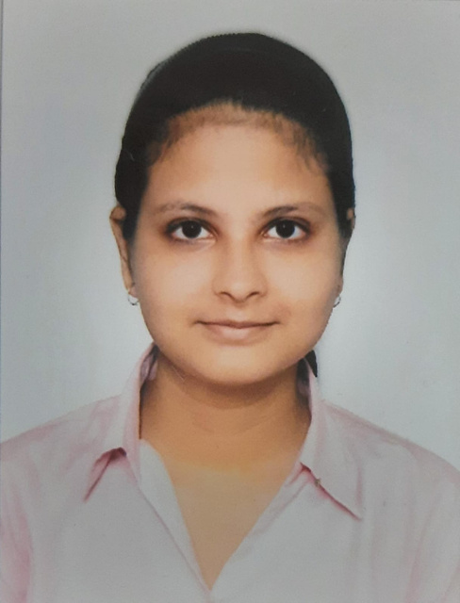

Team: InnovateX
Team Structure
Abhinav T V
Aniket Sawate
Shilpa Kanjilal
Inn
Ayush Singh
Innovator (Design Thinking Lead& Overall Lead)
Innovator (Data Acquisition Lead)
Innovator
(Technical Lead)
Innovator (Management and Business Lead)
IIT Patna

